Slide 1
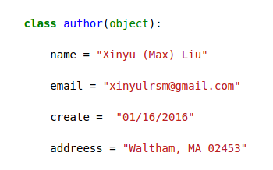
Medicare fraud detection by using open source data

Slide 2

Outline
Fraud detection is important in healthcare.
The data source
Feature engineering
Models
Results

Slide 3
# an image/plot for comparison of fraud and non-fraud
Year | People Charged | False Billings, in Million
2010 | 94 | $251
2011 | 91 | $295
2012 | 2 | $1.9
2013 | 89 | $223
2014
2015 | 243 | $712
Data source: en.Wikipedia.org/wiki/Medicare_fraud

Slide 4
The open source data
Part-D 2013
Payment data 2013

Slide 5
Npi exclusions database

Slide 6
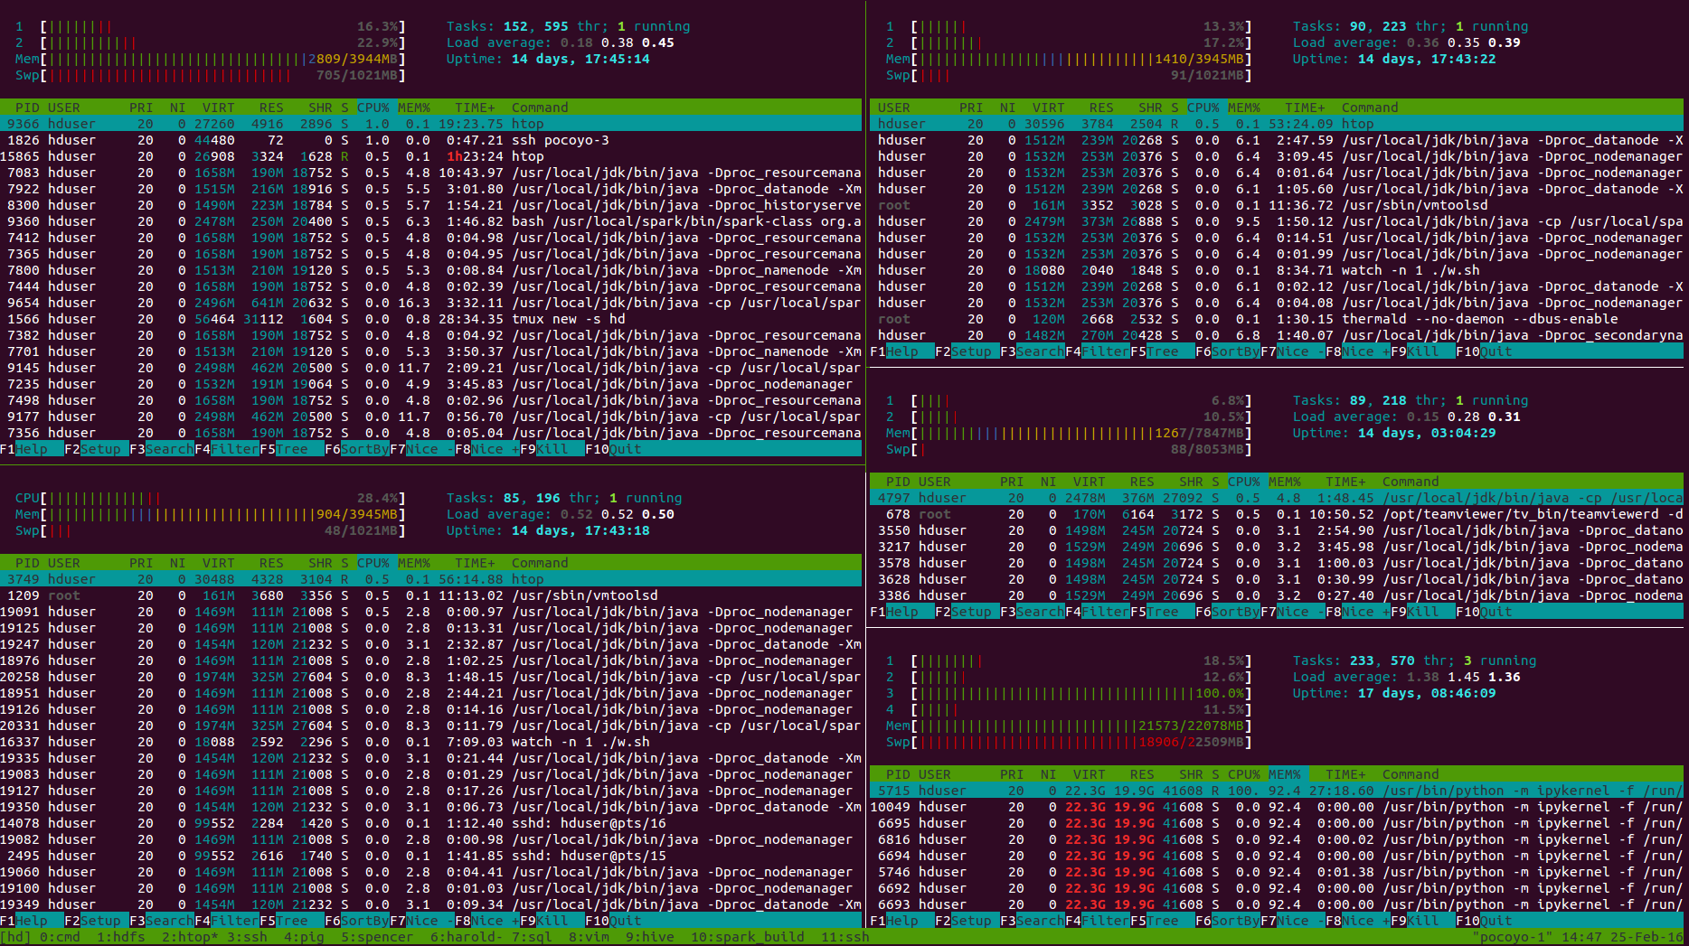
The cluster ( 5 nodes Hadoop/yarn/spark)
Node-1
2 core
4 G mem
Node-2
2 core
4 G mem
Node-4
2 core
8 G mem
Node-3
1 core
4 G mem
Node-5
4 core
22 G mem

Slide 7
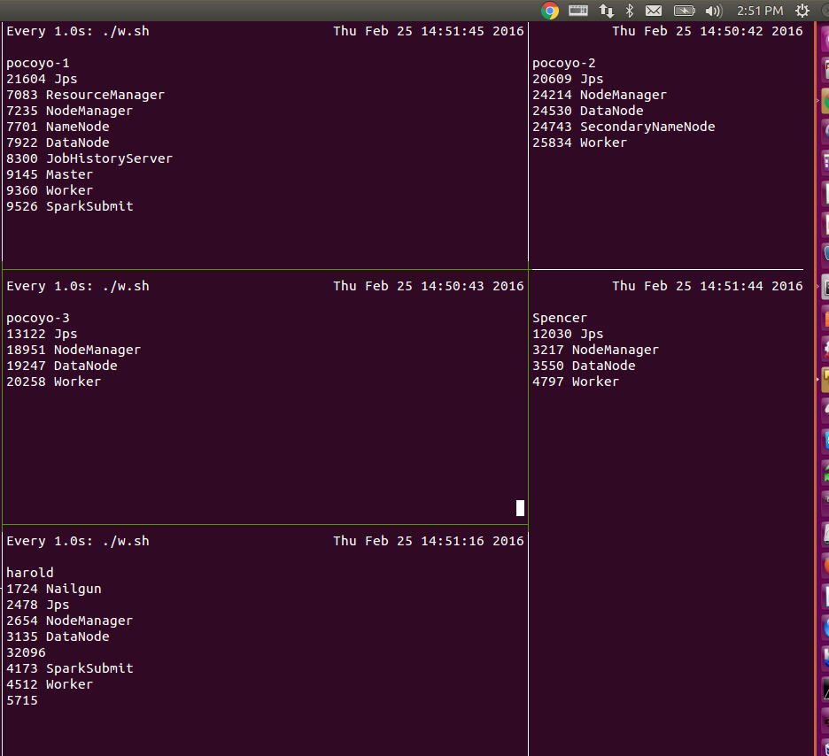
Another way to monitor the cluster

Slide 8
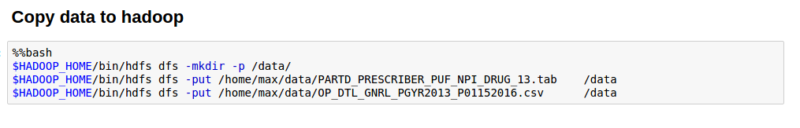
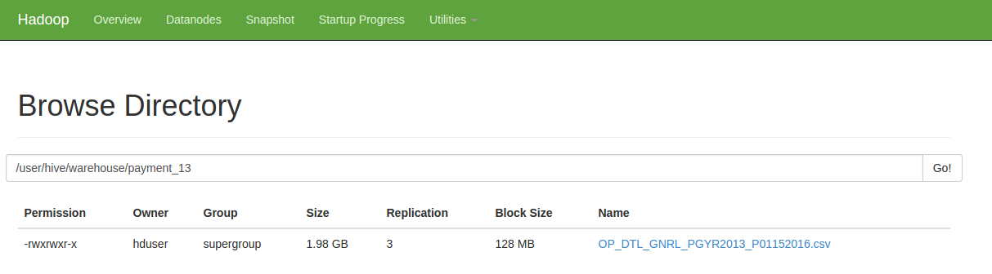
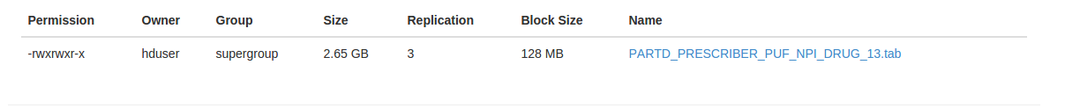
Copy files to Hadoop then move to Hive warehouse

Slide 9
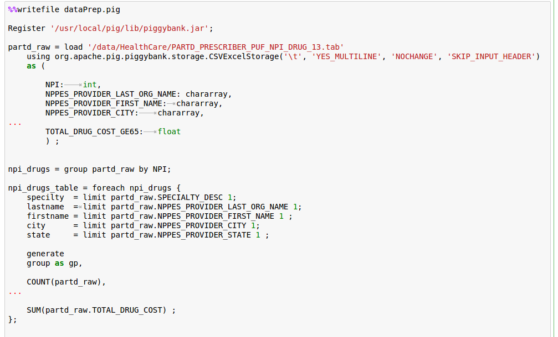
Pig scripts for data cleaning and table join

Slide 10
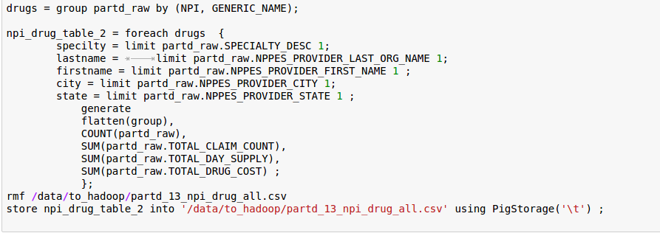

Slide 11
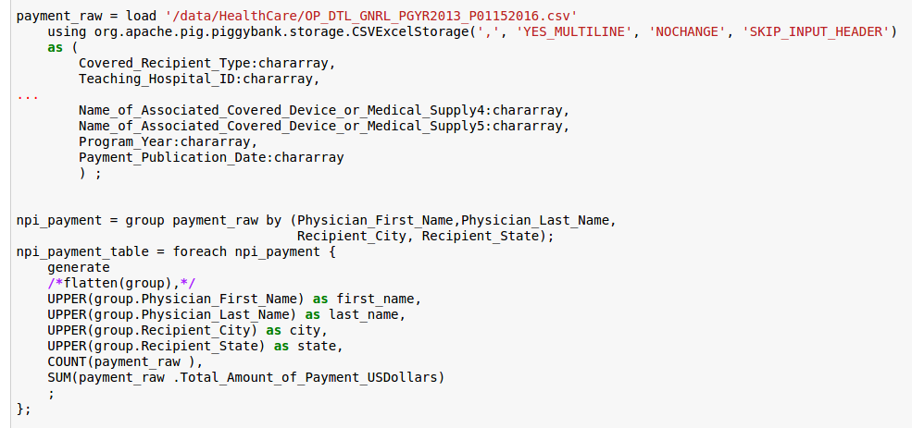

Slide 12
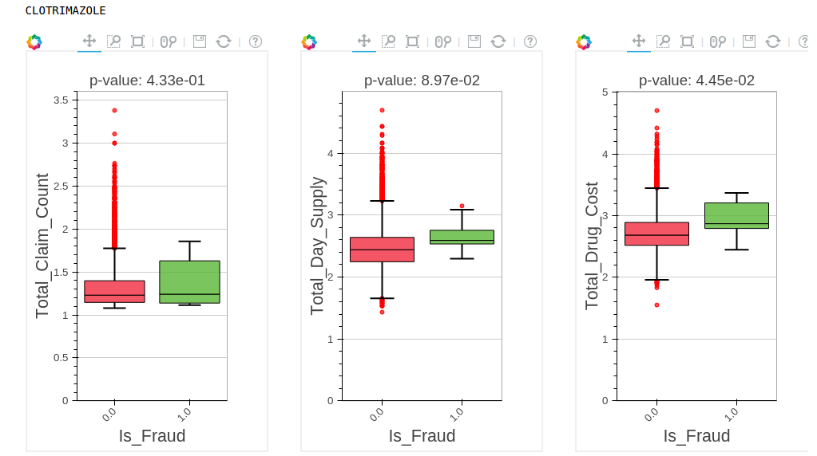
An example

Slide 13
# Plots for the data, histgraph or bar chart

Slide 14
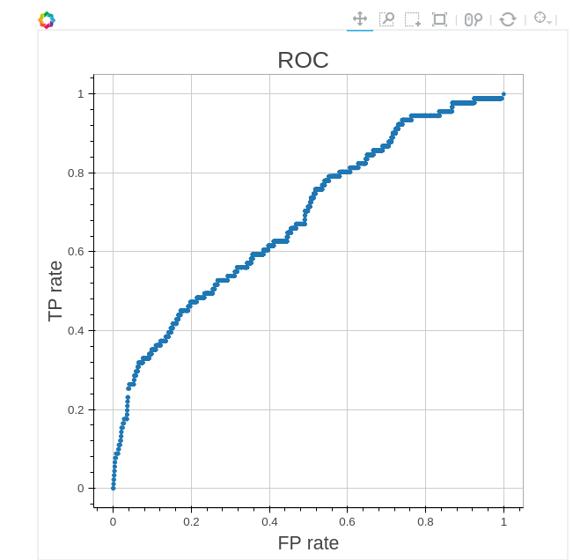
AUC from RandomForest
AUC = 0.685

Slide 15
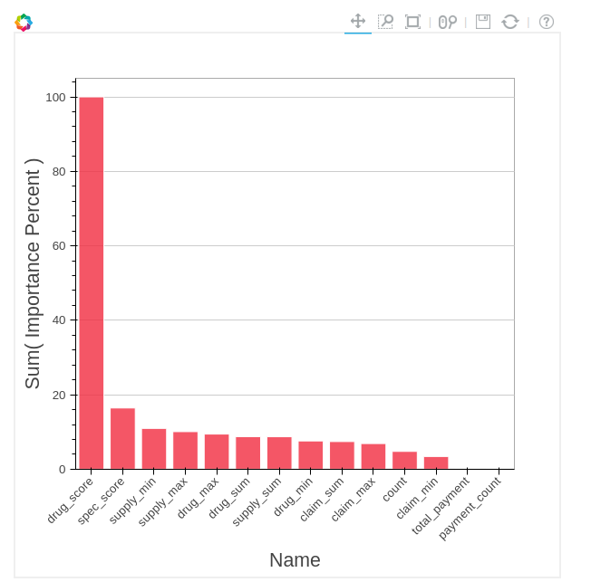

Slide 16
Ways to improve
Use more data, for example the Part-B dataset.
Add Page rank as a feature.
Model blend might help.

Slide 17
References
PageRank for Anomaly Detection by Ofer Mendelevitch and Jiwon Seo https://www.versustexas.com/criminal/healthcare-medicare-medicaid-fraud/

